Slide 1
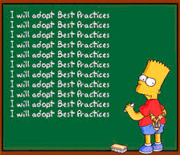
ISO/TC211 Best Practices - why and how
Knut Jetlund

Slide 2
Why do we need Best Practices?
Harmonized models
Design BP
Writing definitions
Naming
Summarize and harmonize modelling and encoding rules
19103, 19109, 19136, 19139
Preparing for implementation
Namespaces
Dependencies

Slide 3
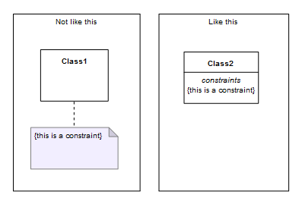
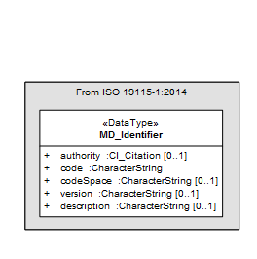
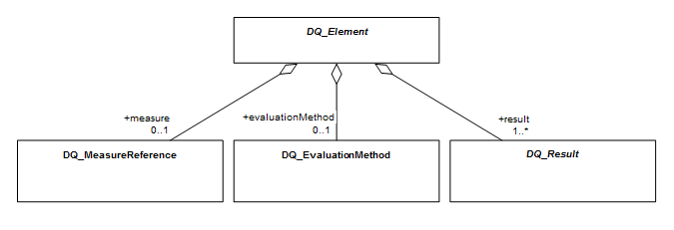
Designing models
Modeling of constraints
Illustrating classes etc. from other standards
Names - prefixes
When to view and hide attributes, operations and constraints
…
…

Slide 4
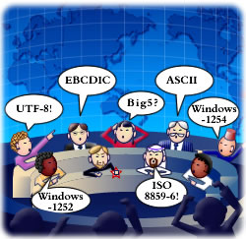
Modelling and encoding rules
19139 (Metadata XML)
19136 (GML)
19103 (CSL)
19109 (Rules for AS)
Summarize and harmonize for Best Practices

Slide 5
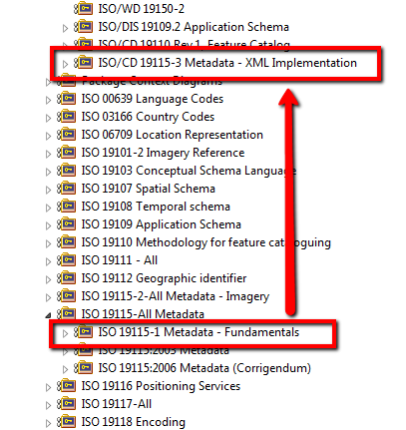
Preparing for implementation
The path from conceptual model to implementation should be as short and easy as possible
Focus on implementation issues when working on the conceptual model
Namespaces
Dependencies

Slide 6
Best practice – a suggestion on how we could do it
What we need:
A manual for developing ISO/TC211 models, securing harmonization and simplifying implementation
Internal document for use in ISO/TC211, not a formal document
Living document, evolving from experiences
http://www.isotc211.org/hmmg/BestPractices
AdHoc group for Best Practices?

